Slide 1
Student Internship Application
By: Collin Easley, Justin Rubio, Kevin Kostage, Andrew Bryan

Slide 2
Tech Stack
GUI - Python using tkinter
DB - SQLite

Slide 3
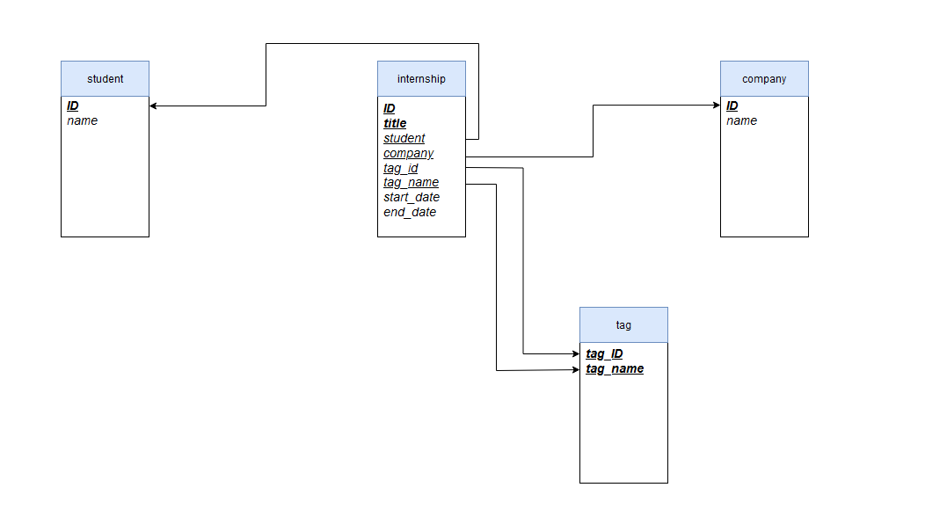
Database Schema

Slide 4
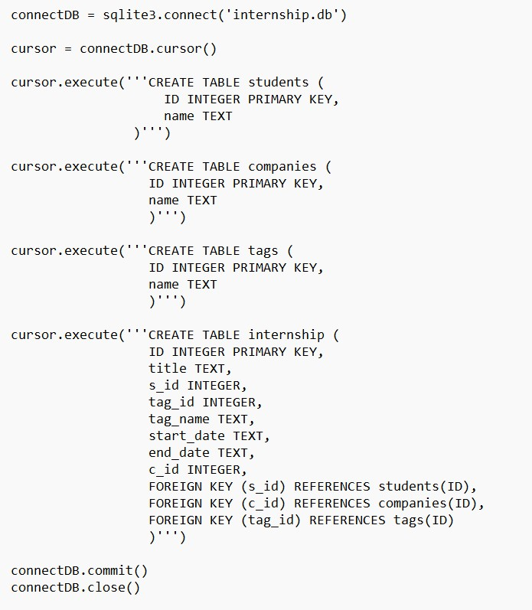
Create Tables in python

Slide 5
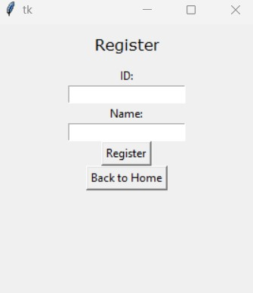
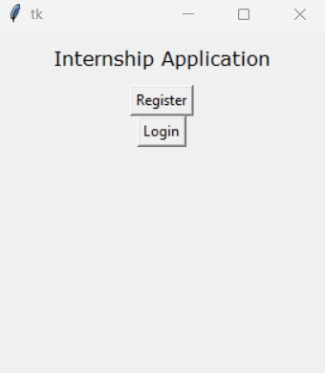
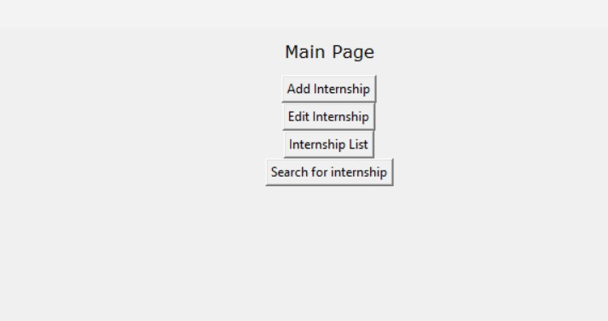
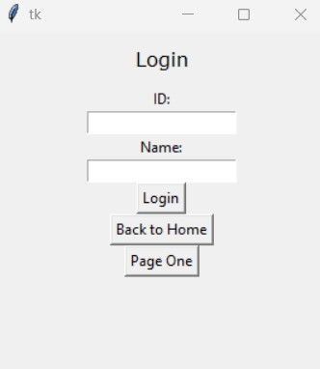

Slide 6
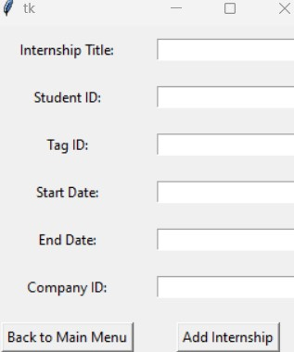
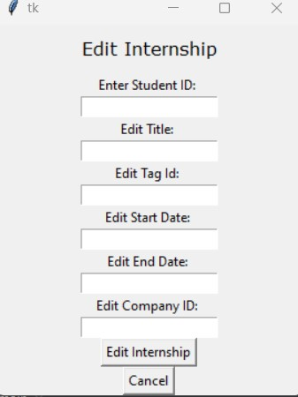

Slide 7

List of internships

Slide 8
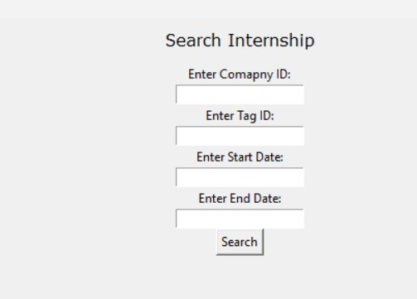
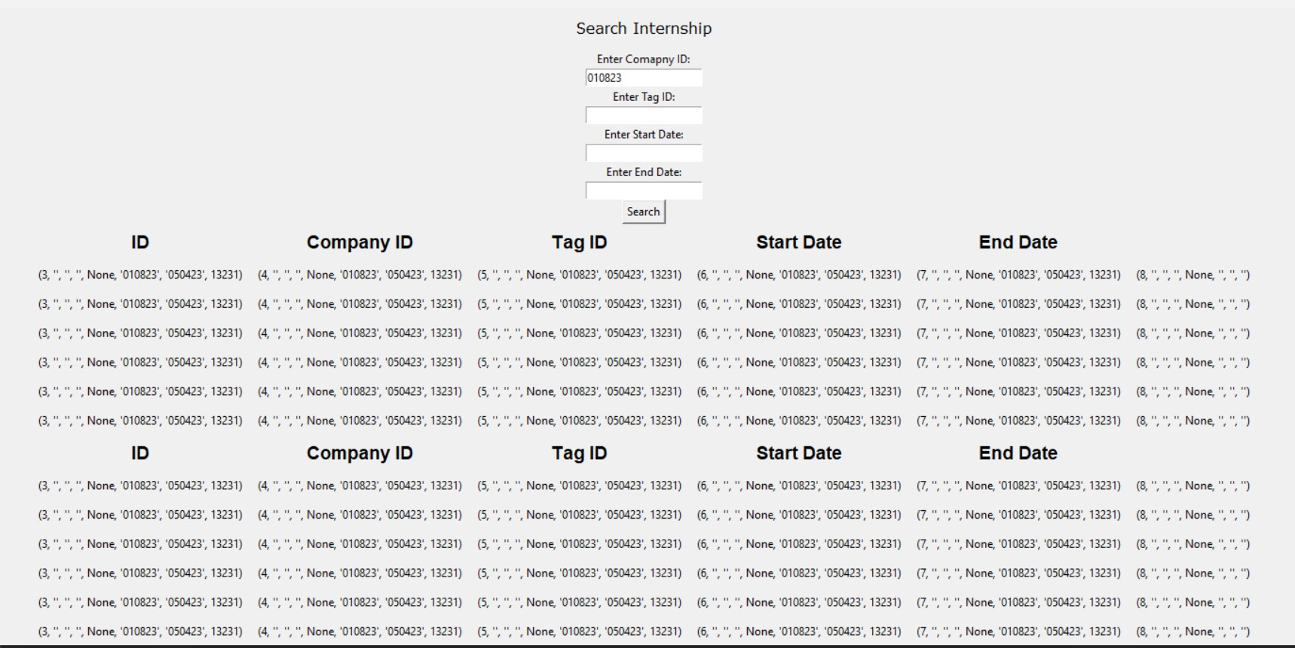
Search for Internship

Slide 9
Questions?

